Slide 1
UFCFB6-30-2 Object-oriented Software Development
Unit 10 GUI and event-driven programming
Benedict R. Gaster
2016-17

Slide 2
Outline
GUI components
To create user interfaces using frames, panels, and some simple UI components
Layout manager
To understand the role of layout managers
To use the FlowLayout, GridLayout, and BorderLayout
To explain the concept of event-driven programming for GUI applications
To understand event, event source, and event classes
To know how to register listener objects with source objects; and to implement listener interfaces
To understand how an event is handled
Drawing and paintComponent
Notes:
GUI builder easy to use. No need to remember details of layout. No need to understand listener. But unnecessary code and cannot do dynamic creation of elements.

Slide 3
Simple GUI(skip)
Show CurrencyGUI Front end
Demo a simple GUI:
Create a “JFrame Form” instead of a “Java class”
Two views: Design and Source code
Add a JPanel, add JLabel. Show Source code
Drag button: change variables and text
Drag textArea: change variables and text
Run to show the look, but no action yet
Note for JS: use SimplGUI and SimpleGUI2 in GUI LectureCoce

Slide 4
Simple GUI(skip)
Add functionality
Complete “actonPerformed method”
Show simple setText in the display area, run
Use JOptionPane to get input
Drag “click here to enter your name”
Enter JOptionPane code
Declare the “name” attribute

Slide 5
CurrencyConvertor (skip)
public class CurrencyConvertor {
private double rate; //rate=1 pound/1 euro
public CurrencyConvertor(Double r){
rate=r;
}
public void setRate(double rate) {
this.rate = rate;
}
double pount2euro(double amount){
return amount*rate;
}
double euro2pound(double amount){
return amount/rate;
}
}
Notes:
Any info that needs to be read in is passed in as parameter. Anything needs to be displayed is returned as result.

Slide 6
CurrencyDemoConsoleUI (fragments)
public void main(…) {
……
rate = console.nextDouble();
con = new CurrencyConvertor(rate);
System.out.println("Enter the amount of money to exchange: ");
amount = console.nextInt();
System.out.println(“ 1. pount2euro \n 2.euro2pound");
choice = console.nextInt();
switch (choice) {
case 1:
result = amount + "in pound is " +
con.pound2euro(amount) + " in euro.";
break;
case 2:
result = amount + "in euro is " +
con.euro2pound(amount) + " in pound.";
break;
}
System.out.println(result);
}

Slide 7
CurrencyDemoGUI (skip)
Create a “JFrame Form” instead of a “Java class”
Two views: Design and Source code
Add a JPanel
Drag and drop the elements to the JPanel
Change the displaying texts
Change the variable names
Add functionality
Need to use another object (CurrencyConvertor)
Declare CurrencyConvertor in the class
Create an instance of CurrencyConvertor in the “set the exchange rate” button
Get input from GUI, ask CurrencyConvertor to do the task, display the result returned from CurrencyConvertor
Show simple setText in the display area, run

Slide 8
CurrencyDemoGUI - set exchange rate
Add functionality to the “set exchange rate” button
Add more variables names, e.g. Currency Convertor
Using JOptionPane
String rateString = JOptionPane.showInputDialog("Enter exchange rate: ");
double rate = Double.parseDouble(rateString);
if (con == null) {
con = new CurrencyConvertor(rate);
} else { con.setRate(rate);}

Slide 9
CurrencyDemoGUI – pound to euro
String amountString = amountField.getText();
double amount = Double.parseDouble(amountString);
resultArea.setText(amount + "in pound is " +
con.pount2euro(amount) +
" in euro.");

Slide 10
Create Tabbed Panes (skip)
Drag a JTabbedPane from the Component Palette onto the Designer .
Drag a JPanel onto the JTabbedPane. This is how you add the first tab.
Drag another JPanel onto the existing tab’s label until you see the orange dashed outline, Drop the JPanel. A second tab appears.This is how you add more tabs.
http://my.safaribooksonline.com/book/programming/java/9780137017256/gui-builder/ch06lev1sec3

Slide 11
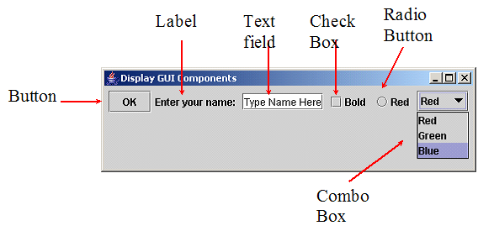
GUI components (skip)

Slide 12
AWT and Swing
Java provides many predefined classes for building GUI applications.
These classes are provided in two packages called: Abstract Windows Toolkit (AWT) and Swing.
In Java, to write a GUI program, we derive new classes from those provided in AWT or Swing.

Slide 13
Creating a frame
import javax.swing.*;
public class MyFrame1 extends JFrame{
MyFrame1(String title) {
setTitle(title);
setSize(400,300);
setDefaultCloseOperation(JFrame.EXIT_ON_CLOSE);
setVisible(true);
}
public static void main(String[] args) {
MyFrame1 frame = new MyFrame1("MyFrame");
}
}
Note for me: code is in lectue folder/guiexamples/guiexamples

Slide 14
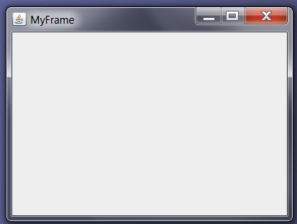
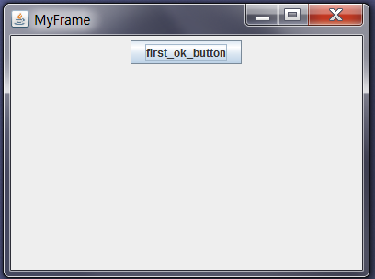
Adding components to a frame
Container contentPane = getContentPane();
//obtain the content pane of the frame
JPanel p1 = new JPanel();
contentPane.add(p1);
JButton ok = new JButton("first_ok_button");
//create a button object
p1.add(ok); // could just do add(ok)
Notes:
API from J2SE 1.5 and 6:
The JFrame class is slightly incompatible with Frame. Like all other JFC/Swing top-level containers, a JFrame contains a JRootPane as its only child. The content pane provided by the root pane should, as a rule, contain all the non-menu components displayed by the JFrame. This is different from the AWT Frame case. As a conveniance add and its variants, remove and setLayout have been overridden to forward to the contentPane as necessary. This means you can write:
frame.add(child);
's not two competing mechanisms - a JPanel is a Container (just look at the class hierarchy at the top of the JPanel javadocs). JFrame.getContentPane() just returns a Container to place theComponents that you want to display in the JFrame. Internally, it's using a JPanel (by default - you can change this by calling setContentPane()) As for why it's returning a Container instead of aJPanel - it's because you should program to an interface, not an implementation - at that level, all that you need to care about is that you can add Components to something - and even though Containeris a class rather than an interface - it provides the interface needed to do exactly that.
As for why both JFrame.add() and JFrame.getContentPane().add() both do the same thing -JFrame.add() is overridden to call JFrame.getContentPane().add(). This wasn't always the case - pre-JDK 1.5 you always had to specify JFrame.getContentPane().add() explicitly andJFrame.add() threw a RuntimeException if you called it, but due to many complaints, this was changed in JDK 1.5 to do what you'd expect.

Slide 15
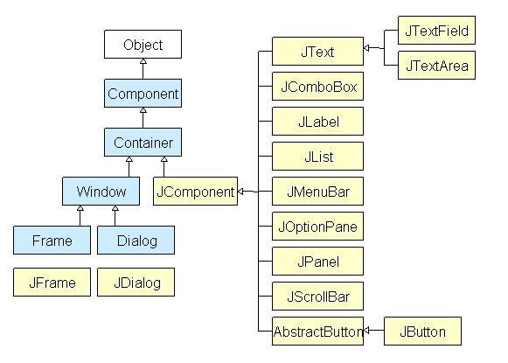
Some GUI Components (1)

Slide 16
Some GUI Components (2)
The Component class provides methods such as setting and getting background colours.
The Container class provides methods for adding component to the container; setting layout manager; and painting the component.

Slide 17
JButton
Mostly used constructors.
JButton(String text)
JButton ok = new JButton("first_ok_button");
JButton also inherits all the methods in its super classes such as setBackgroundColor

Slide 18
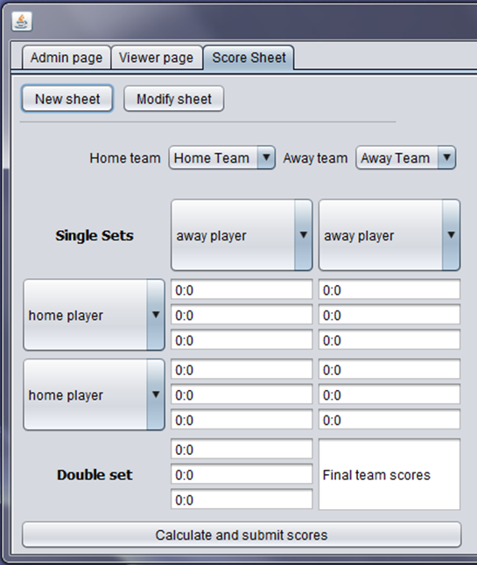
JTextField
A JTextField: user input area.
Commonly used constructors and methods are:
JTextField(int columns)
JTextField(String text)
Mostly used methods:
getText()
setText(String text)

Slide 19
JLabel
A JLabel is a display area for a short text.
Constructors and methods include the following:
JLabel()
JLabel(String text)
setText(String text)
getText()

Slide 20
Container and JPanel
Containers can contain a number of components, e.g. frames and panels are containers
JPanel is a subclass of JComponent
Used as container or sub-containers for grouping user interface components
We can use the add method to put components in a container:
JPanel p1 = new JPanel();
JButton ok = new JButton("first_ok_button");
p1.add(ok)

Slide 21
Layout Manger
Controls how the GUI components within the container can be arranged
Java provides a number of predefined layout managers.
FlowLayout
GridLayout
BorderLayout
Containers has a method
setLayout(LayoutManager)

Slide 22
FlowLayout
FlowLayout is the simplest layout manager.
The components are arranged in the container from left to right in the order in which they were added.
When one row becomes filled, a new row is started.

Slide 23
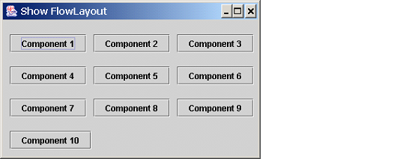
Output from the ShowFlowLayout program
Notes for me: code in lectures/guiexamples/practical exercises

Slide 24
FlowLayout: Fragment of code
public class ShowFlowLayout extends JFrame {
public ShowFlowLayout() {
Container container = getContentPane();
container.setLayout(new FlowLayout());
for (int i = 1; i <= 10; i++)
container.add(new JButton("Component " + i));
}
public static void main(String[] args) {
ShowFlowLayout frame =
new ShowFlowLayout();
……
}
}

Slide 25
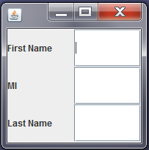
GridLayout
The GridLayout manager arranges components in a grid (matrix) formation with the number of rows and columns defined by the constructor.
The components are placed in the grid from left to right starting with the first row, then the second, and so on.

Slide 26
GridLayout: Fragment of code
public class ShowGridLayout extends JFrame {
public ShowGridLayout() {
Container container = getContentPane();
container.setLayout(new GridLayout(3,2));
container.add(new JLabel("First Name"));
container.add(new JTextField());
container.add(new JLabel("MI"));
container.add(new JTextField());
container.add(new JLabel("Last Name"));
container.add(new JTextField());
}
……
}
Notes:
GridLayout fill up the cell. SO container.add(new JTextField(1)); has no effect
The container is divided into equal-sized rectangles, and one component is placed in each rectangle.

Slide 27
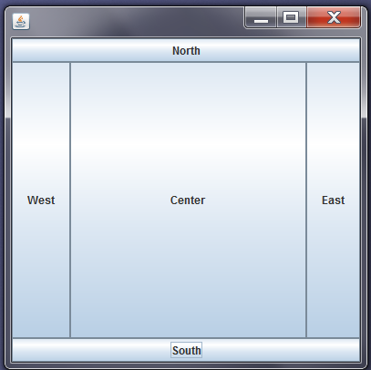
BorderLayout
Divides the container into five areas: East, South, West, North, and Center.
To add a component to a particular area, we use the add(Component, constraint) method, where constraint is
BorderLayout.EAST,
BorderLayout.SOUTH,
BorderLayout.WEST,
BorderLayout.NORTH,
BorderLayout.CENTER

Slide 28
BorderLayout: code fragment
public class ShowBorderLayout extends JFrame {
public ShowBorderLayout() {
Container container = getContentPane();
container.add(new JButton("East"),
BorderLayout.EAST);
container.add(new JButton("South"),
BorderLayout.SOUTH);
container.add(new JButton("West"),
BorderLayout.WEST);
container.add(new JButton("North"),
BorderLayout.NORTH);
container.add(new JButton("Center"),
BorderLayout.CENTER);
}
……

Slide 29
Java GUI programming is event-driven
In Java GUI components allow users to interact with them, which generate events. Actions can be taken to respond to the events.
Download the ShowActionEvent progem from Blackboard. Compile and run ShowActionEvent.

Slide 30
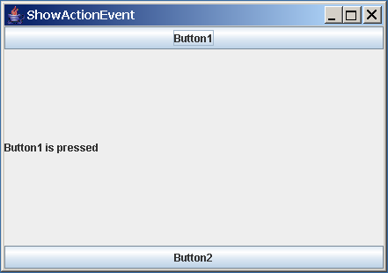
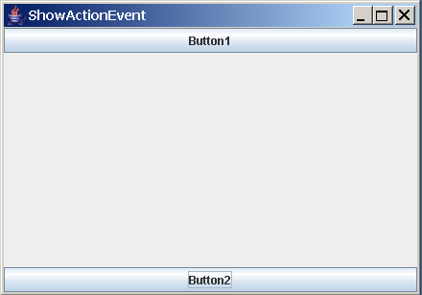
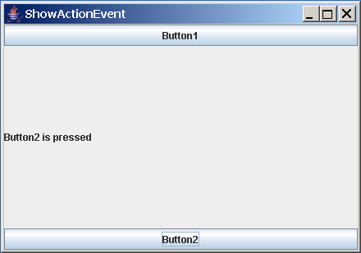
ShowActionEvent

Slide 31
Events and event source
Events: mouse movements, mouse clicks, and keystrokes or by the operating system, such as a timer.
Java has pre-defined classes to represent different kinds of events. Each kind of event is defined as a class.
For example, ActionEvent defines events such as pressing a button; WindowEvent defines events such as closing or opening a window;

Slide 32
Source object of an event
The object in which an event is generated is called the source object.
The two button objects are the source objects of the events generated when the buttons are pressed
To identify the source object of an event, we use the getSource() method in the event class.

Slide 33
User actions, source objects and related events.
User Action | Source Object | Generated Event
Click a button | JButton | ActionEvent
Press return on a text field | JTextField | ActionEvent
Select an item | JList | ListSelectionEvent

Slide 34
Listeners, listener interfaces and event handlers
Once an event is generated, it needs to be listened by an object: the listener.
The listener object receives information about these events and takes some actions to respond to these events, i.e. to handle the events.
The actions for handling the events are defined in the methods specified in the relevant listener interface.
The listener object’s class must implement the corresponding event-listener interface. The listener object must register with the source object.

Slide 35
Event and corresponding Listener interface
Event Class | Listener Interface | Listener Methods (Handlers)
ActionEvent | ActionListener | actionPerformed(ActionEvent)
WindowEvent | WindowListener | windowClosing(WindowEvent)
 |  | windowOpened(WindowEvent)
 |  | windowIconified(WindowEvent)
 |  | windowDeiconified(WindowEvent)
 |  | windowClosed(WindowEvent)
 |  | windowActivated(WindowEvent)
 |  | windowDeactivated(WindowEvent)
MouseEvent | MouseListener | mousePressed(MouseEvent)
 |  | mouseReleased(MouseEvent)
 |  | mouseClicked(MouseEvent)
 |  | mouseExited(MouseEvent)
 |  | mouseEntered(MouseEvent)

Slide 36
Registering with source objects Implement event listener(skip)
For ShowActionEvent, listener is “this” object
ShowActionEvent implements ActionListener
//Register this object as the listener for
//events generated by the two buttons
button1.addActionListener(this);
button2.addActionListener(this);

Slide 37
Student activity 1 (skip)
Explore the effect of registering listener.
Modify the ShowActionEvent example by removing the
button1.addActionListener(this);
button2.addActionListener(this);
Compile and run the program again. Now click on Button1 and Button2, observe what happens and try to explain why.

Slide 38
Handling events (skip)
// implement the actionPerformed method
// as specified in the
// ActionListener interface
public void actionPerformed(ActionEvent e) {
msg.setText(e.getActionCommand()+
" is pressed");
}
Notes:
getActionCommand() gives you a String representing the action command. The value is component specific; for a JButton you have the option to set the value with setActionCommand(String command)but for a JTextField if you don't set this, it will automatically give you the value of the text field. According to the javadoc this is for compatability with java.awt.TextField.
getSource() is specified by the EventObject class that ActionEvent is a child of (viajava.awt.AWTEvent). This gives you a reference to the object that the event came from.

Slide 39
ShowActionEvent- explained 1 (skip)
The class has two buttons and one label.
private JButton button1 = new JButton("Button1");
private JButton button2 = new JButton("Button2");
private JLabel msg = new JLabel();
It uses the default BorderLayoutManager. It places button1 at North, button2 at South and the label msg in the Center
// Get the content pane of the frame
Container container = getContentPane();
// Add buttons to the frame
container.add(button1,BorderLayout.NORTH);
container.add(button2,BorderLayout.SOUTH);
container.add(msg,BorderLayout.CENTER);

Slide 40
ShowActionEvent- explained 2 (skip)
“this” object is registered with the two buttons to listen to events generated by these two buttons.
// Register this object as the listener for
// events generated by the two buttons
button1.addActionListener(this);
button2.addActionListener(this);
The class of “this” object, i.e. ShowActionEvent, implements ActionListener.
public class ShowActionEvent extends JFrame
implements ActionListener {
… …
}

Slide 41
ShowActionEvent- explained 3 (skip)
ShowActionEvent implements the method in ActionListener, i.e. the actionPerformed() method.
// implement the actionPerformed method as
// specified in the ActionListener interface
public void actionPerformed(ActionEvent e) {
msg.setText(e.getActionCommand()+" is pressed");
}

Slide 42

ShowActionEvent
public class ShowActionEvent extends JFrame implements ActionListener {
private JButton button1 = new JButton("Button1");
private JButton button2 = new JButton("Button2");
private JLabel msg = new JLabel();
public ShowActionEvent() {
// Get the content pane of the frame
Container container = getContentPane();
// Add buttons to the frame
container.add(button1,BorderLayout.NORTH);
container.add(button2,BorderLayout.SOUTH);
container.add(msg,BorderLayout.CENTER);
// Register this object as the listener
// for events generated by the two buttons
button1.addActionListener(this);
button2.addActionListener(this);
}

Slide 43
ShowActionEvent
// implement the actionPerformed method as specified
// in the ActionListener interface
public void actionPerformed(ActionEvent e) {
msg.setText(e.getActionCommand()+" is pressed");
}
/** Main method */
public static void main(String[] args) {
ShowActionEvent frame = new ShowActionEvent();
frame.setTitle("ShowActionEvent");
frame.setDefaultCloseOperation(JFrame.EXIT_ON_CLOSE);
frame.setSize(200, 200);
frame.setVisible(true);
}
}

Slide 44
Summery for event-driven GUI programming
understand the concepts of event (event class) and event source
know how to register listener objects with source objects; and to implement listener interfaces
understand how an event is handled
be able to write simple Java event-driven GUI applications.

Slide 45
The Color class
You can set colours for GUI components by using the java.awt.Color class.
MyFrame(String title) {
… …
Container container = getContentPane();
JButton ok = new JButton("first_ok_button");
container.add(ok);
ok.setBackground(Color.red);
container.setBackground(Color.green);
… …
}

Slide 46
Drawing and images
Usually create a new class that extends JPanel and override the paintComponent (Graphics g) method
The Graphics object g is created automatically by the Java Virtual Machine for every visible GUI component.

Slide 47
Some methods in the Graphics object
drawLine(50,50,100,60), draws a line from (50,50) to (100,60)
drawRect(20,20,100,50), draws a rectangle with (20,20) as the top left corner; 100 is the length and 50 is the width.
fillRect(20,20,100,50), draws a rectangle as above but filled with the current colour.
g.drawImage(img, x, y, null), draws the image at (x,y)
setColor(Color.red), sets of colour of the graphics object to be red.

Slide 48
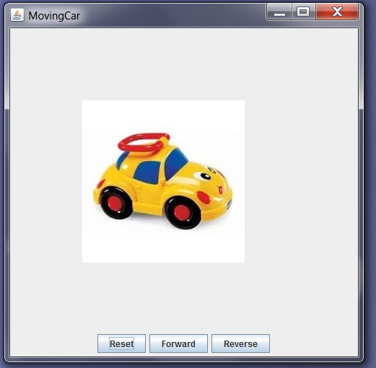
Two classes:
MovingSimpleCar: deals with the interaction on the GUI
ToyCar: deals with the painting

Slide 49
paintComponent – the toy car example
public class ToyCar extends JPanel {
BufferedImage img;
int x, y;//position of car
ToyCar() {
…
img = ImageIO.read(new File("toycar.jpg"));
…
}
… //other methods that changes the car positions,
… //e.g. reset(), forward() etc
public void paintComponent(Graphics g) {
super.paintComponent(g);
g.drawImage(img, x, y, null);
}
}

Slide 50
Fragments of the code for driving the toy car
public class MovingSimpleCar extends JFrame implements ActionListener {
//declare the buttons etc
ToyCar car = new ToyCar();
public MovingSimpleCar () {
// code for creating a panel for grouping all the buttons and adding buttons and car to the panel
reset.addActionListener(this);
forward.addActionListener(this);
reverse.addActionListener(this);
}
@Override
public void actionPerformed(ActionEvent e) {
if (e.getSource() == reset) { car.reset(); } //you need to define a reset method in the ToyCar class; it sets the position of car
if (e.getSource() == forward) {…}
if (e.getSource() == reverse) {…}
car.repaint(); //repaint() will trigger the system to call the paintComponent() method in car
}

Slide 51
JavaFX
JavaFX is a software platform for creating and delivering desktop applications.
JavaFX is intended to replace Swing as the standard GUI library for Java SE, but both will be included for the foreseeable future.
JavaFX has support for desktop computers and web browsers.
http://docs.oracle.com/javafx/2/get_started/jfxpub-get_started.htm
http://www.dummies.com/how-to/content/10-differences-between-javafx-and-swing.html

